Slide 1
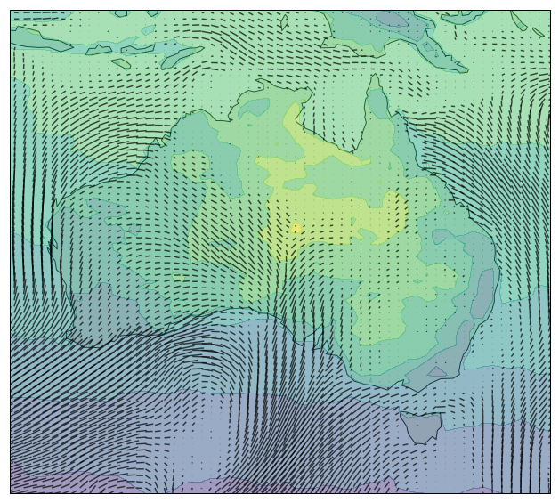
GA 7.1 n216 Scott Wales & Holger Wolff
ARCCSS CMS
Aim:
Reproduce a current high-resolution climate run from the Met Office, as exactly as possible
Uses:
Diagnose land surface and CABLE integration issues
Enable high resolution Transpose-AMIP runs for CLEX process studies
Daily mean temp + wind, 1950-01-05, data courtesy UKMO

Slide 2
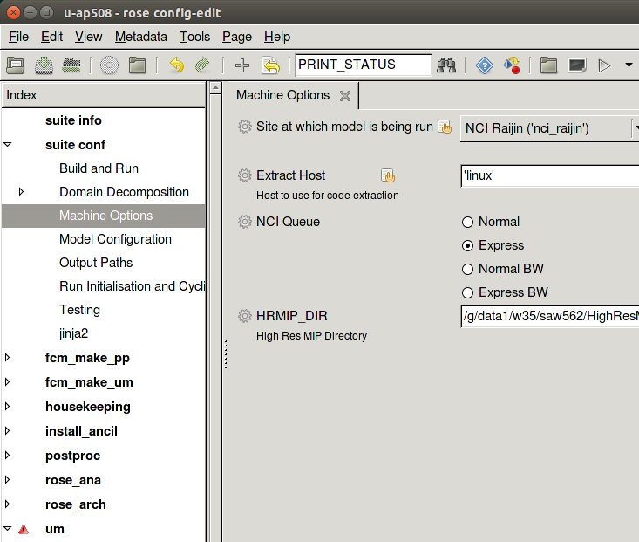
Source Job & Porting
Based on the GA7.1 HighResMIP run by the Hadley Centre, uses the faster EasyAerosol scheme
NCI site information is in the GA7.1 trunk, porting to Raijin involved minor changes and tuning the decomposition
Model runs at 28 hours per model year, costing 11 kSU per model year

Slide 3
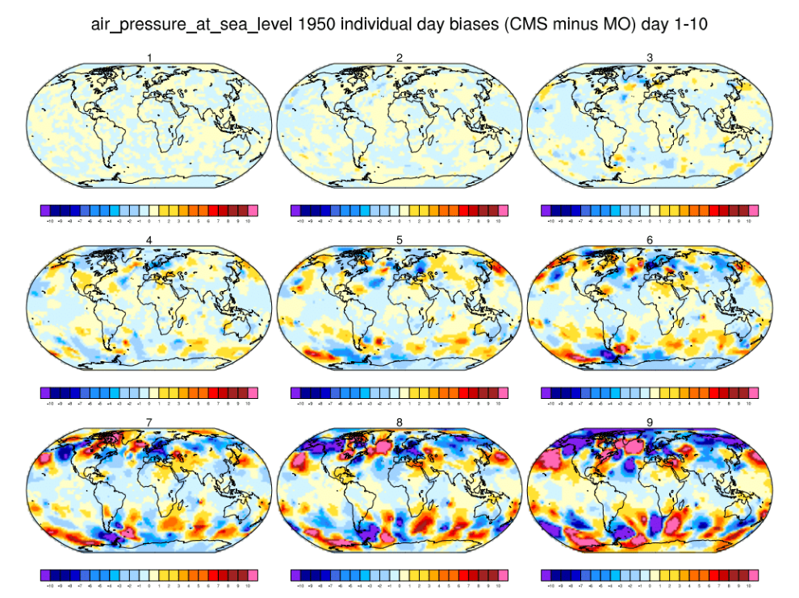
AMIP
One model year complete, scientific validation in progress by Peter Gibson (ARCCSS/UNSW)
Once match with UKMO results is good we will progress to JULES and CABLE bug fixes, running these for longer periods
The aim of these tests is to improve model results for both JULES and the UM, and to show the effectiveness of CABLE
Rose ID - u-an493

Slide 4
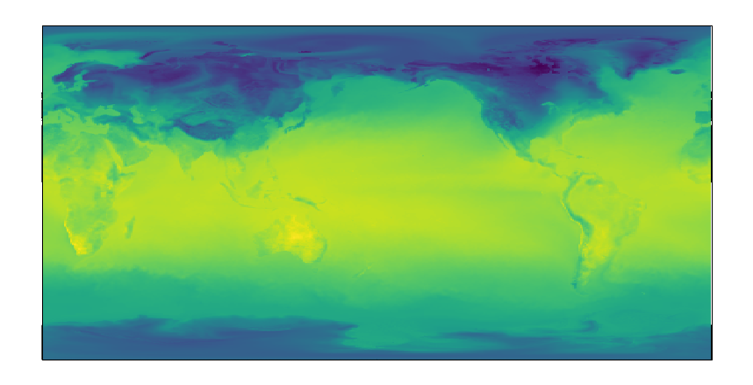
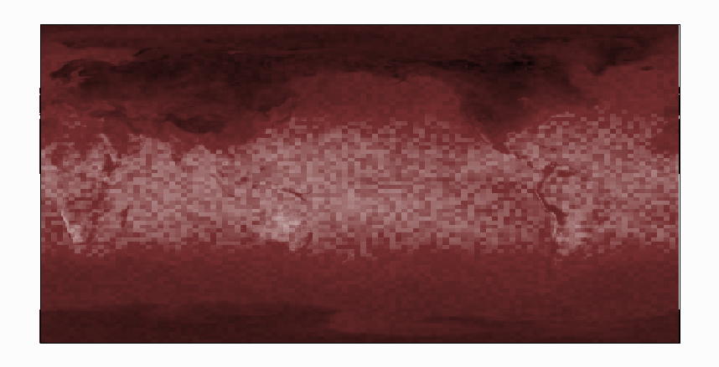
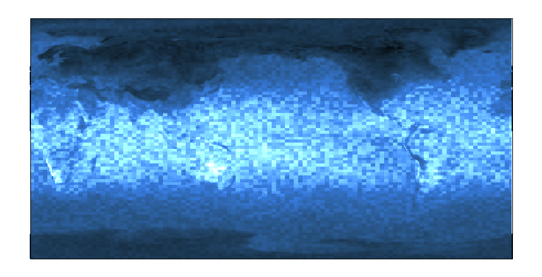
Previous Test
UKMO
NCI
How do we check two model runs with different compilers / libraries are giving the same results?
Run an ensemble with input fields perturbed by 1 ULP for each compiler, check if the results are sampled from the same distribution
Developed by João Teixeira at UKMO

Slide 5
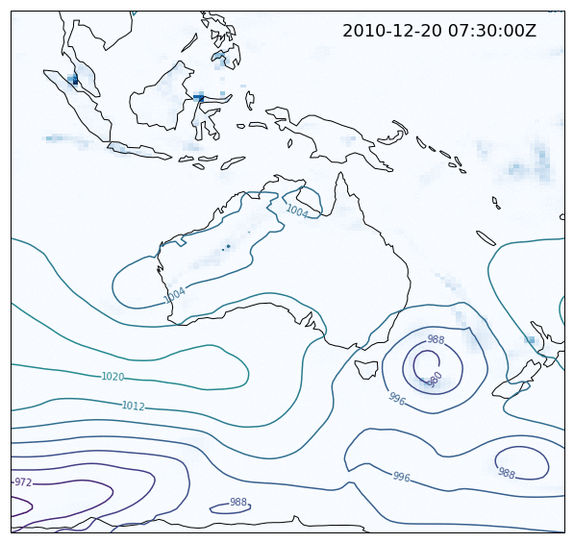
Transpose AMIP
Initialise the model from ERA-Interim results at an arbitrary start date
Builds on work done at BoM
Allows for high-resolution modelling of the processes around extreme events
Rose ID - u-ap508
Precipitation and Surface Pressure, Brisbane floods Dec. 2010/2011

Slide 6
More Info
CMS Wiki: http://climate-cms.unsw.wikispaces.net/High+Res+MIP
Help: climate_cms@nci.org.au

